Slide 1
Business Ethics

Slide 2
CHAPTER GOALS
Learn about business ethics
Learn a Listening Strategy: Recognize lecture language that signals a new idea or a transition to a new idea in a lecture
Learn a Note-taking Strategy: Use symbols and abbreviations-use sign replace for words
Learn a Discussion Strategy: Ask for clarification and elaboration-short form of words

Slide 3
Build Background Knowledge
corporate crime
business ethics
Bankrupt
shareholder
crimes committed either by a corporation or by individuals acting on behalf of a corporation
standards governing commercial relationships
unable to pay one's debts
a person who owns shares in a company

Slide 4
Executive- giam doc dieu hanh
Fraud-gian lan
Corruption
-tham nhung
Conscience – luong tam
Scandal
- Be boi
someone in a high position, especially in business
Cheating
illegal, immoral or dishonest behaviour
sense of right and wrong
an action, situation, or behavior that shocks people

Slide 5
Accountability –trach nhiem giai trinh
responsibility

Slide 6
Prepare to Listen and Take Notes
Recognize Lecture Language for Transitions
During a lecture, professors often signal when they are introducing or changing topics or ideas
Listen for transitions—the words and expressions that professors use to indicate when they are moving to a new idea

Slide 7
Transition lecture language
Read the expressions that signal a new idea or a transition to a new idea in a lecture
Let me start with ...
Let's start by . .
First we're going to look at.
Now let's talk about...
Now that we've talked about
Okay, let s move on to . .
Next, I'd like to discuss . . .
Let's look at/take a look at. .

Slide 8
Another way that a professor can signal a transition is to ask a rhetorical question.
Rhetorical questions are given for the purpose of preparing the listener for the answer
They are not questions that the professor wants students to answer.
How can we explain this? Well,. .
What does this all mean? Let's look at..

Slide 9
Recognize lecture language
2. Read the excerpt from a lecture about corporate responsibility. Underline the lecture language that signals a transition

Slide 10
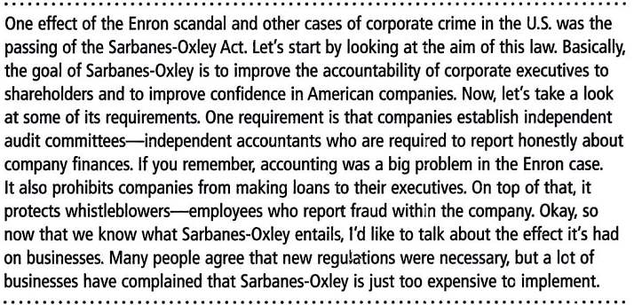

Slide 11
3. Listen to the beginning of a lecture about the ethical behavior of men and women executives. Then write T for true or F for false next to each statement.
1. Corporations with both men and women on the board of directors set the same ethical standards as corporations led by men only. F
2. Women commit more crimes that involve stealing from their employers. F ( MEN )
3. Women tend to steal larger amounts of money over longer periods of time T

Slide 12
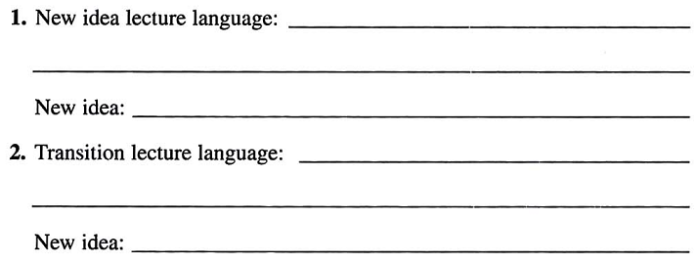
4. Listen to the lecture again. As you listen, write down the lecture language that signals a transition or a new idea. Then listen once more and write down the idea that follows the transition

Slide 13


Slide 14
Note-taking Strategy
Use Symbols and Abbreviations
Because professors often speak quickly
Use symbols and abbreviations in place of full words and phrases in order to write down ideas more quickly
Use symbols and abbreviations
5. Look at these commonly used symbols and abbreviations. Can you think of any others?

Slide 15
= equals, is the same
% percent
+ and
/ or
⇩to go down, decrease, lower
⇧to go up, increase, higher
< is less than
is more than
# number
etc. and so on
e.g. for example
i.e. that is

Slide 16
Imp important
w/ with
w/out without
Sb somebody, someone
Sth something
b/t between

Slide 17
6. Think about the words that you might use to take notes in a lecture on business ethics. How could you abbreviate those words?
company – co
Employee – emp’ee
Executive - exec
Employer – emp
Manager – mgr & mngr
Independent - ind
Corporation - corp

Slide 18
Listen and Take Notes
4. Use your notes to answer these questions
What is the goal of business ethics?
give emp’ee a sense of how to do business responsibly
2. What are two examples of the impact of corruption on companies and the economy?
Survey in 2002, reports of corporate corruption

Slide 19
3. How can promoting business ethics help a company to succeed?
Avoid scandals
Create a better work environment and more profitable business
4. Name three things that can be done to encourage an ethical work environment
Establish codes of ethics
Train emp’ees how to follow the rules
Survey emp’ee for evaluation

Slide 20
Summarize the Lecture A good way to help remember the information in a lecture is to put the key ideas into your own words
This will also help you confirm that you understood the lecture and that your notes are complete
As soon as possible after a lecture, put the key ideas into your own words and speak them out loud to a study partner or to yourself

Slide 21
Do you think most company leaders want to do what is best for themselves, or what is best for their employees?
Do you think your business leader or president is honest? Do you think your supervisor is honest? Do you think most of your co-workers are honest?
Do you think women are more ethical at work than men?

